Slide 1
Basics of 2D geometric objects

Slide 2
objectives
To understand the architecture and operations of a 2D graphics system
To understand 2D coordinate systems and equations of graphs
To be able to identify the various coordinate spaces in a rendering pipeline
To understand Java 2D program structure and the Graphics2D object
To graph equations with Java programs
To use basic 2D geometric primitives

Slide 3
Basics of 2D geometric objects
Points that are uniquely defined by their x- and y-coordinate.
Lines, polylines or curves can be defined by two or more points.
For a line two points are needed, curves require additional control points.
Polylines are connected sequences of lines.
Areas are usually bounded by closed polylines or polygons.
Areas can be filled with a colour or a texture.

Slide 4
Rendering Pipeline
The graphic objects are constructed from basic primitives such as lines, polygons, and ellipses.
The model may also include objects such as texts and images
The transformations involved in 2D graphics are affine transforms.
The object transformations change the shapes and locations of the visual objects to which the transforms are applied.
The viewing transformations do not change the virtual world model, but they change the view of the entire scene on the world space
Example:
In a virtual model with a circle and a triangle, a translation applied to a circle as an object transformation will move only the circle without changing the rectangle. A translation as a viewing transforms will move the entire view.

Slide 5
2D Coordinate System
In order to represent geometry precisely and efficiently in computers, coordinate systems are employed.
The most commonly used 2D coordinate system employs rectangular (Cartesian) coordinates.

Slide 6
Line
A line can be represented by a polynomial equation of degree 1

Slide 7
Circle and ellipse
A circle centered at the origin with radius R is represented by the equation:
x²+y²=r²
Ellipse is defined by the standard equation:
y
x

Slide 8
Parametric equations
In a parametric equation a third variable t is introduced
Both x and y are expressed as functions of t
Example: Parametric equation of an ellipse:

Slide 9
Spaces
The collection of all points or coordinates is known as a space
Three types of spaces are typically involved in a graphics system
Object space
World space
Device space
Each space is usually characterized by its own coordinate system
Object space
Also known as local or modeling coordinate system
Associated with the definition of a particular graphic object
In constructing such an object, it is usually convenient to choose a coordinate system that is natural to the object
For example: when we define a circle, we may choose to have the origin of the coordinate system at the center of the circle and simple define a unit circle

Slide 10
spaces
World space
Known as user coordinate system
Define a common reference space for all objects in a graphic model
Geometric objects are placed into this space through object transforms
Device space
Represent the display space of an output device such as a screen or a printer.
Example Java panel:

Slide 11
The Java Graphics2D Class
In Java 2D, the rendering engine is accessed through the class Graphics2D
In the early versions of Java, graphics drawings are obtained through the class java.awt.Graphics
The Graphics class contains basic methods for rendering graphic primitives
Java 2D uses the more extensive Graphics2D class for its rendering
Graphics2G extends the graphics to maintain compatibility with earlier AWT rendering
Graphics2D and Graphics classes are abstract, so you can’t instantiate directly

Slide 12
The Graphics2D Class
Two ways to retrieve a Graphic2D object
Obtain as a parameter in the paint component method:
Obtain a reference to a Graphics2D object is to call the method getGraphics:
void paintComponent(Graphics g){
}
The parameter g is declared to be Graphics, but it is also a Graphics2D object.
It can be a cast to graphics 2D object
Graphics getGraphics()

Slide 13
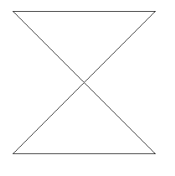
Graphics and 2D Graphics
In Graphics (AWT) there is no separation between the modular and renderer
For example: a single method drawOval is responsible for both defining (modeling) an ellipse and drawing (rendering) the ellipse
In Graphics2D a separation between modeling and rendering
For example: to draw an Ellipse, you can create an instance of Ellipse2D (which implements the shape interface) and call the draw method to render it.
Example:
(30,30)
(200,30)
public void paintComponent(Graphics g) {
super.paintComponent(g);
g.drawLine(30,30,200,30);
g.drawLine(200,30,30,200);
g.drawLine(30,200,200,200);
g.drawLine(200,200,30,30);
}
(30,200)
(200,200)

Slide 14
Graphics and 2D Graphics
Try using only the function drawLine to plot the 10 digits –approximately- {0,1,2 …9}
Example for the digit 2

Slide 15
Graphing equations
Mathematical equations are important in modeling graphics objects
Plotting an equation is a simple graphics application
A simple way to graph an equation is to generate a sequence of coordinated satisfying the equation and then plot the points
For a function of the form y=f(x), it is straightforward to choose a set of x-coordinates and calculate the corresponding y-coordinates
An equation of form F(x,y)=0 is more difficult to calculate so it can be expressed in parametric form that is convenient for calculations

Slide 16
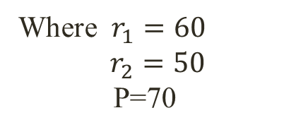
Graphing a Spirograph
The parametric equation for Spirograph:

Slide 17
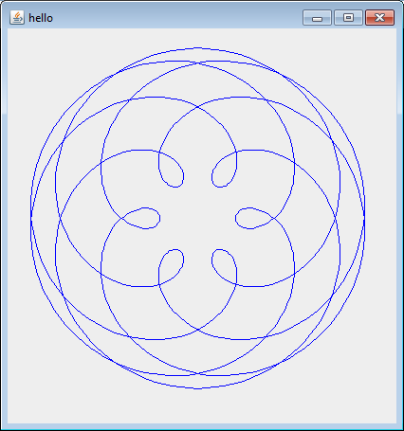
Graphing a Spirograph
public void paintComponent(Graphics g){ super.paintComponent(g); Graphics g2=(Graphics)g; g2.translate(200,200); g2.setColor(Color.blue);
double r1=60, r2=50, p=70;
int nPoints=1000;
int x1 = (int)(r1+r2-p);
int y1 =0;
int x2;
int y2;
for (int i=0; i<nPoints; i++){
double t=i*Math.PI/90;
x2 = (int)((r1+r2)*Math.cos(t)-p*Math.cos((r1+r2)*t/r2));
y2 = (int)((r1+r2)*Math.sin(t)-p*Math.sin((r1+r2)*t/r2));
g2.drawLine(x1,y1,x2,y2);
x1=x2;
y1=y2; }}

Slide 18
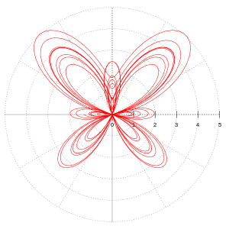
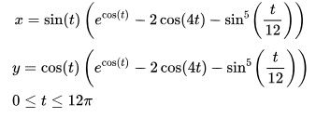
Graphing a butterfly

Slide 19
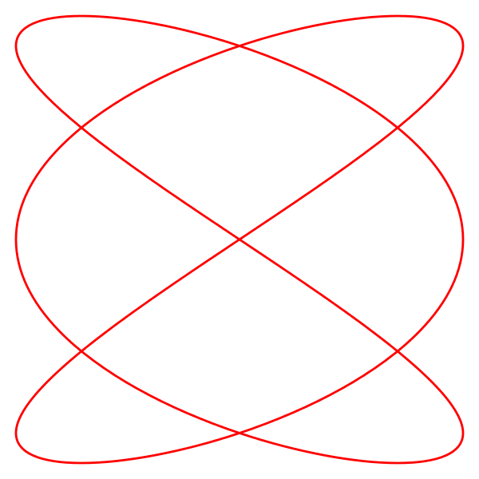

Graphing Lissajous curve

Slide 20
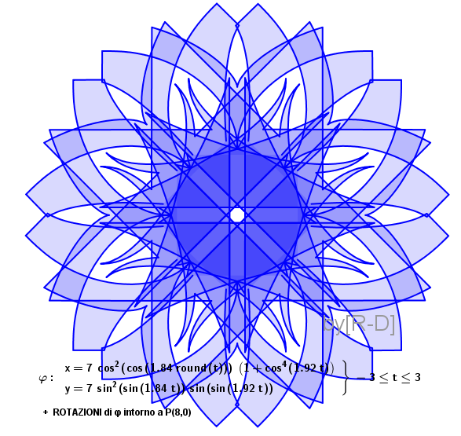
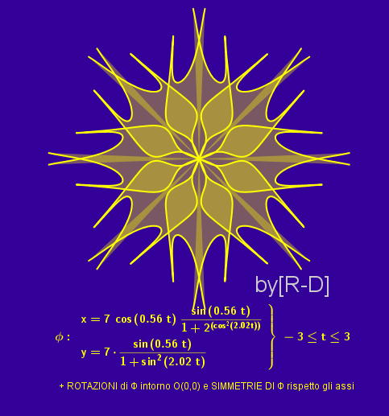
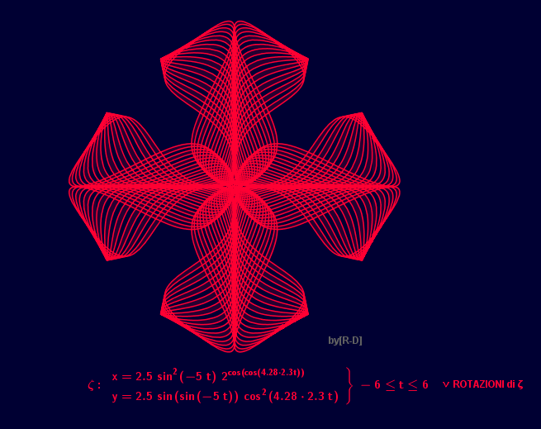
Exercise
You can search the internet for fancy set of parametric equations.

